Slide 1


Automatic Street Lighting System
Digital Logic Design: Final Project Demo
No | Name | Roll No
1 | Guthi Harsha Deep | 2620030193
2 | Gangesh Chandra | 2620030426
3 | Shashank Verma | 2620030229
4 | Sai Bhuvan Krishna | 2620030239
5 | Koushik Muniganti | 22620030440
Section: 1

Slide 2








Introduction and Objective
Street lights often stay ON in daylight or on empty roads, wasting energy
Our system switches the light automatically using simple digital logic
Inputs: D (dark = 1), M (motion detected), E (enable switch)
Day: OFF
Output LL turns the lamp ON only when it is dark and enabled or motion is seen
Objective: save energy while keeping roads lit when needed
Night: ON

Slide 3





Theory and Logic Circuit
Light is ON when D·E + D·M = 1
M
OR
Factor with the distributive law: LL = D·(M + E)
E
AND
LL
Gates used: one OR (M, E) and one AND (with D)
D
Daytime (D = 0) forces LL = 0
LL = D · (M + E)

Slide 4

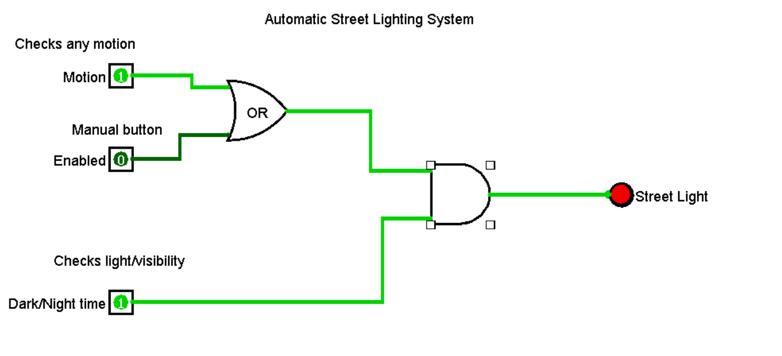

Circuit Design in Logisim
Three input pins: D, M, E
OR gate combines M and E
Paste your Logisim circuit screenshot here
AND gate joins that result with D
Output pin LL drives an LED (the street lamp)

Slide 5

Simulation Results
D | M | E | LL
0 | 0 | 0 | 0
0 | 0 | 1 | 0
0 | 1 | 0 | 0
0 | 1 | 1 | 0
1 | 0 | 0 | 0
1 | 0 | 1 | 1
1 | 1 | 0 | 1
1 | 1 | 1 | 1
Paste Logisim simulation screenshots here (e.g. D=1, M=1, E=0 gives LL=1)
Simulated output matches the truth table in all 8 input combinations

Slide 6



Conclusion and Applications
Outcome
Applications
Improvements
LL = D·(M + E) built in Logisim and verified against the truth table
Highways, campuses, parking lots, smart-city street lighting
Add a timer counter, RAM settings, multi-zone decoder, solar power

